Slide 1
SIIRE GRE Workshop
Dr. Kim LaScola Needy
Dr. Manuel D. Rossetti
Abbie Lasater, Ryan Sanders, Justin Taylor
Notes:
Dr. Needy

Slide 2
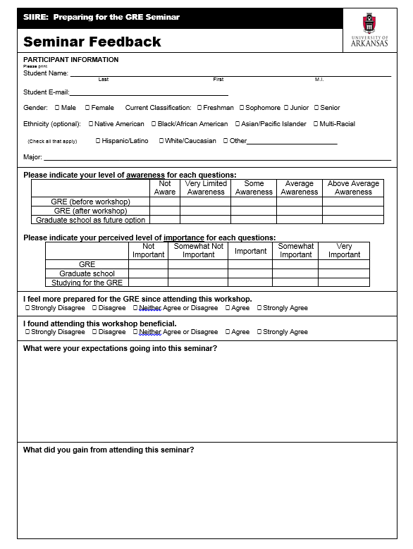
Help Improve this Seminar!
Notes:
Dr. Needy

Slide 3
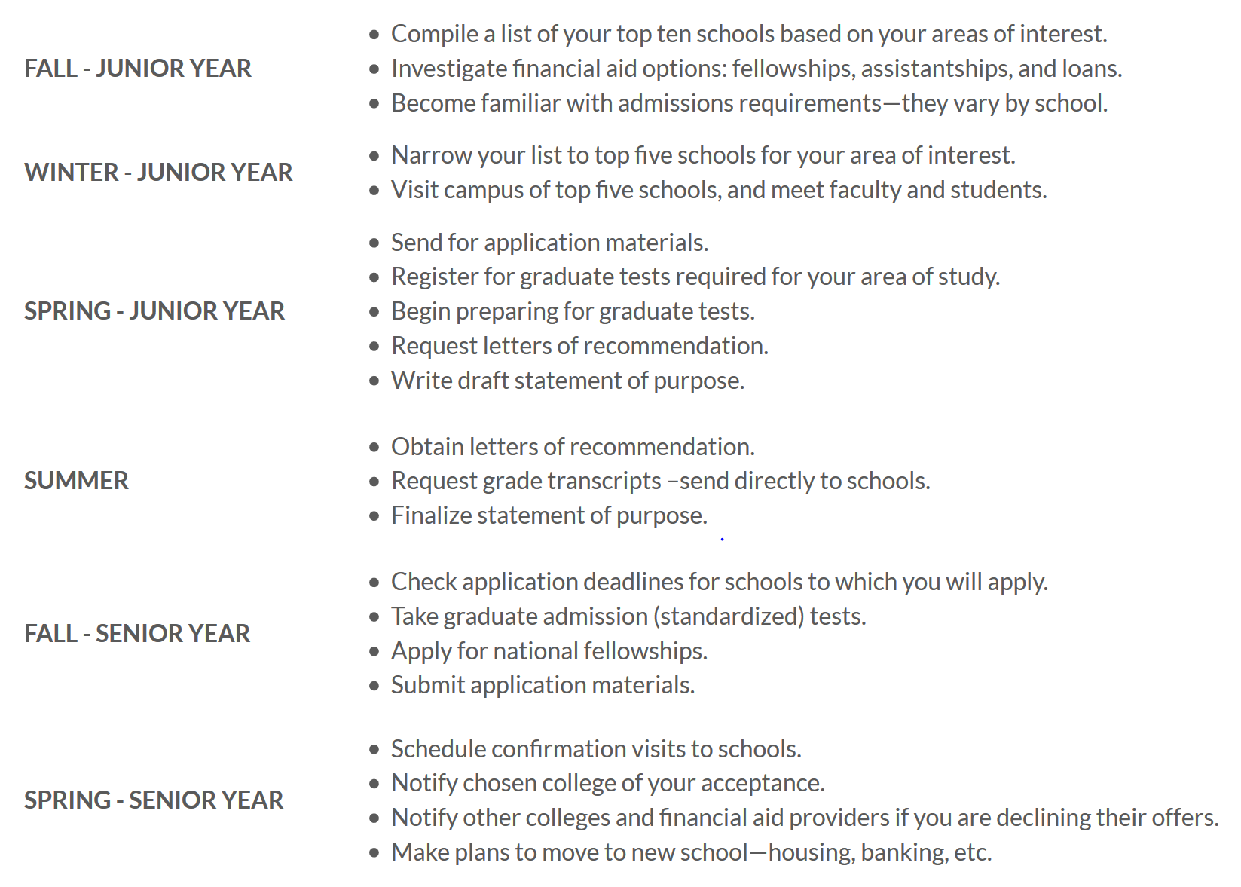
Preparing for Graduate School
Notes:
Dr. Needy

Slide 4
Applying to Graduate School
Four items get you started:
Fill out the online application: http://graduate-recruitment.uark.edu/applying/index.php
Pay the application fee.
Submit transcripts from all colleges and universities attended since high school. There is no need to submit transcripts for course work taken at the University of Arkansas, Fayetteville.
Submit GRE scores. School code is 6866.
Notes:
Dr. Needy

Slide 5
Application Review
Your application is reviewed by the Graduate and International Admissions office. If you meet the requirements for admission into graduate school, your file will be forwarded to the department for an admission decision.
Minimum requirement for admission into graduate school is an earned baccalaureate from an accredited school with a 3.0 GPA on the last 60 hours of the degree, or a cumulative 3.0 GPA
The program may have additional admission requirements:
Letters of recommendation, a personal statement, a resume
Notes:
Dr. Needy

Slide 6
How GRE Scores Are Used
As part of the admission review
Some programs have established minimum scores that students must earn in order to be admitted into the program
Check with the graduate coordinator for the program, or
Check the program’s web site
When deciding which students to nominate for a Distinguished Doctoral Fellowship or Doctoral Academy Fellowship
There are minimum GPA and GRE score requirements
The fellowships provide a supplemental stipend of either $22,000 per year for 4 years or $12,000 per year for four years
Added to the graduate assistant package that includes monthly stipend, tuition waiver and health insurance premium discount
Notes:
Dr. Needy

Slide 7
GRE Not Required For:
MS and PhD* applicants to Electrical Engineering if the student holds a BSEE from the University of Arkansas
Applicants to the online MS in Engineering
MS and PhD* applicants to Microelectronics-Photonics
Applicants to the MSOM in Operations Management if the student received a 3.0 GPA or above on bachelor’s degree
*…unless you are hoping to be nominated for a doctoral fellowship
Notes:
Dr. Needy

Slide 8
Required Exams
GRE – What we are going to focus on
GRE Discipline Specific Test – Biochemistry, Cell and Molecular Biology, Biology Chemistry, Math, Physics
GMAT – Business School
MCAT – Medical School
LSAT – Law School
Notes:
Kim

Slide 9
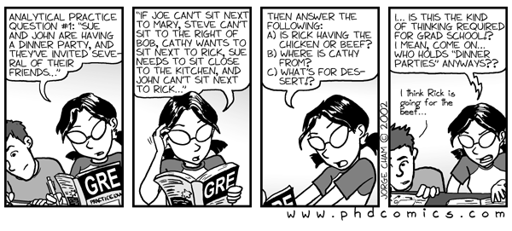
What is the GRE?
the GRE exam is a broad assessment of your critical thinking, analytical writing, verbal reasoning, and quantitative reasoning skills — all skills developed over the course of many years.
Notes:
Manuel
https://www.youtube.com/watch?v=mWT-_IpWl6M
Walk students through soundless demo…stop at 1:44
Start back at 4:31

Slide 10
Think GRE as…
Notes:
Manuel
https://www.youtube.com/watch?v=mWT-_IpWl6M
Walk students through soundless demo…stop at 1:44
Start back at 4:31

Slide 11
Registering for the GRE

Slide 12
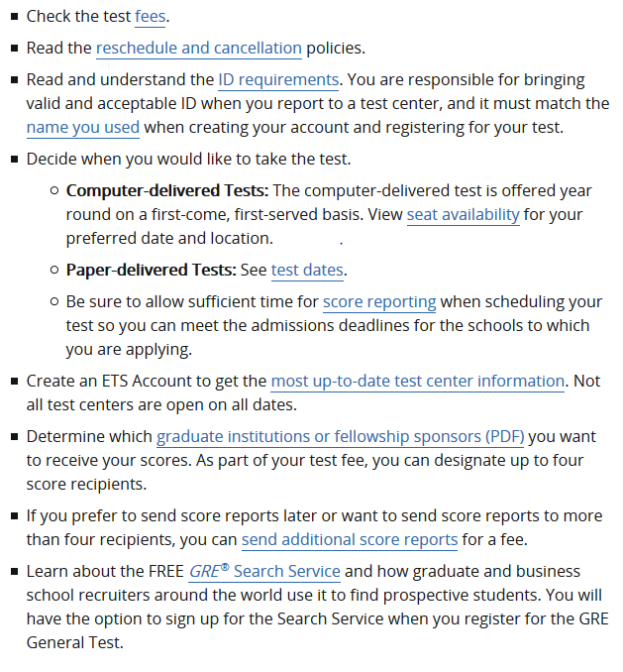
Registration Checklist
Notes:
Manuel
https://www.youtube.com/watch?v=mWT-_IpWl6M
Walk students through soundless demo…stop at 1:44
Start back at 4:31

Slide 13
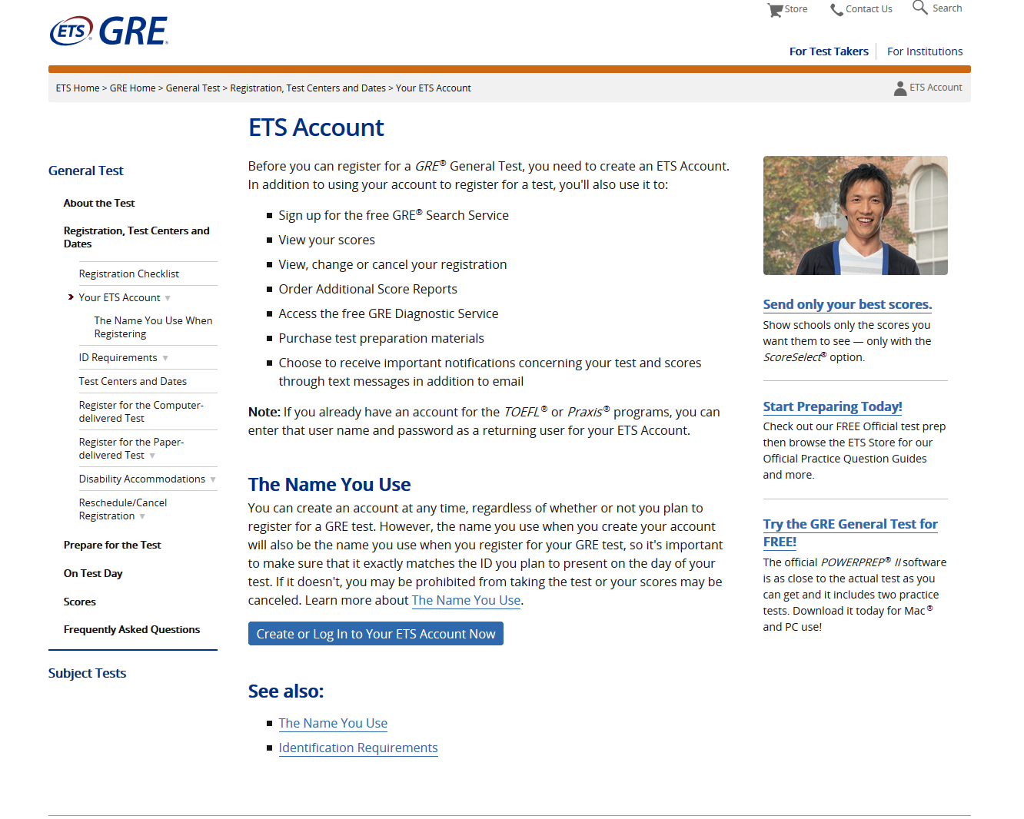
Create Account
Notes:
Manuel
https://www.youtube.com/watch?v=mWT-_IpWl6M
Walk students through soundless demo…stop at 1:44
Start back at 4:31

Slide 14
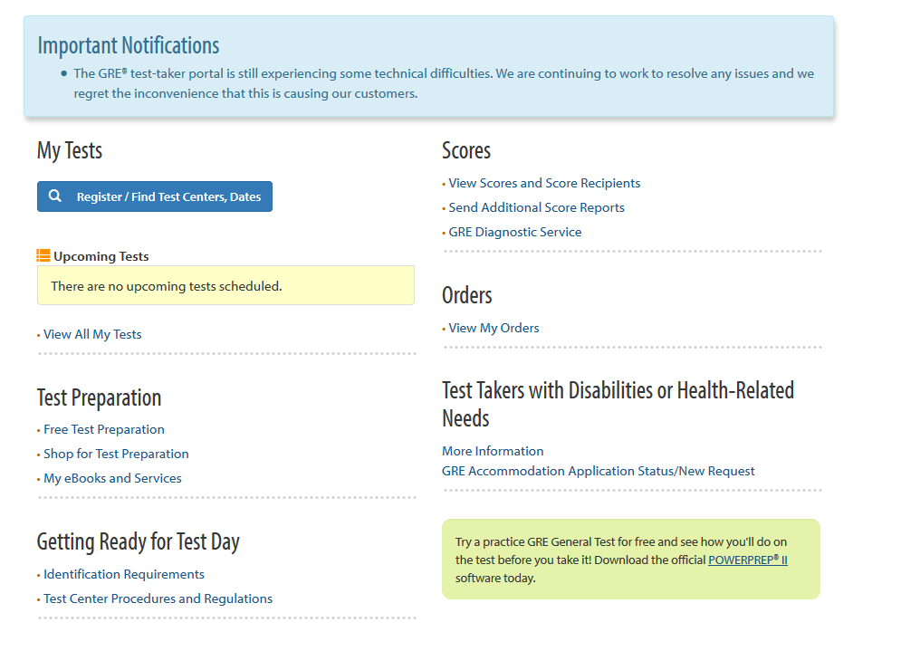
My GRE Home
Notes:
Manuel

Slide 15
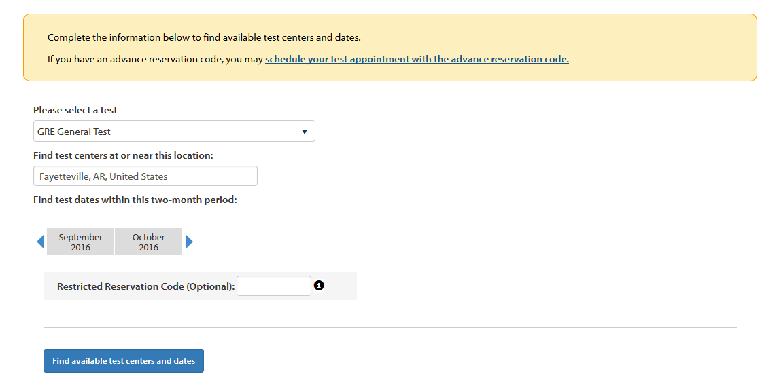
Find Test Centers & Dates
Be sure to select General test for engineering
Notes:
Manuel

Slide 16
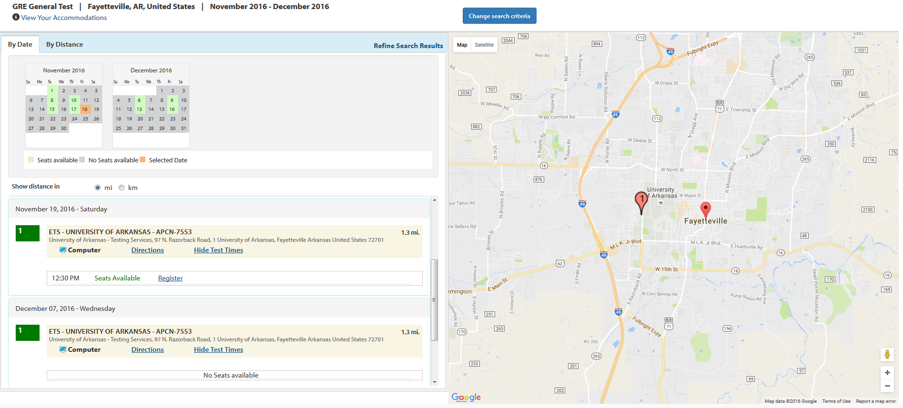
Find Test Centers & Dates
Notes:
Manuel

Slide 17
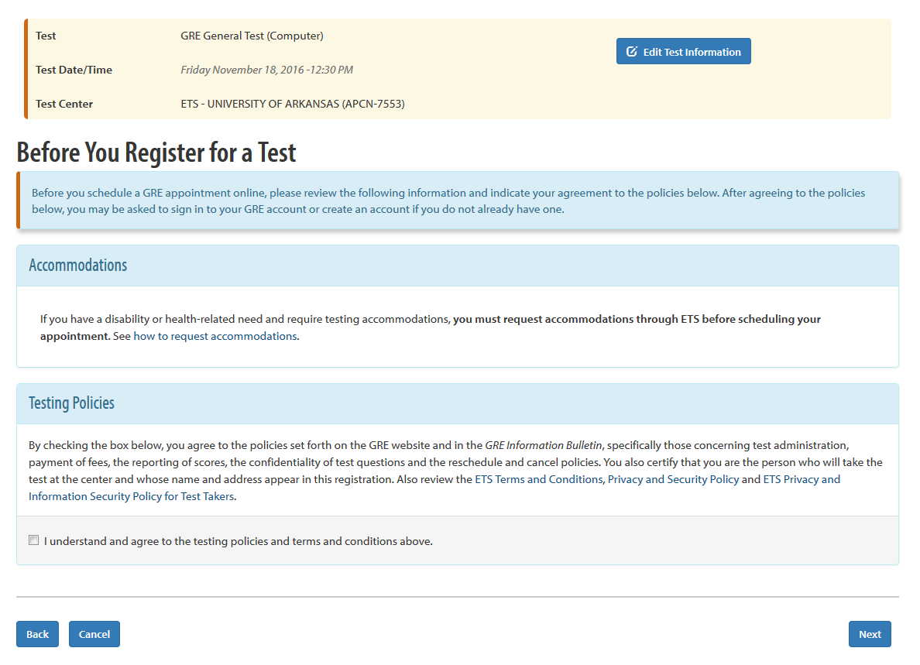
Notes:
Manuel

Slide 18
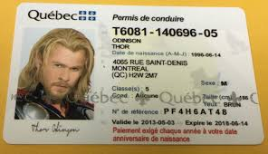
Complete Personal Information
Use information on official documents
Notes:
Manuel

Slide 19
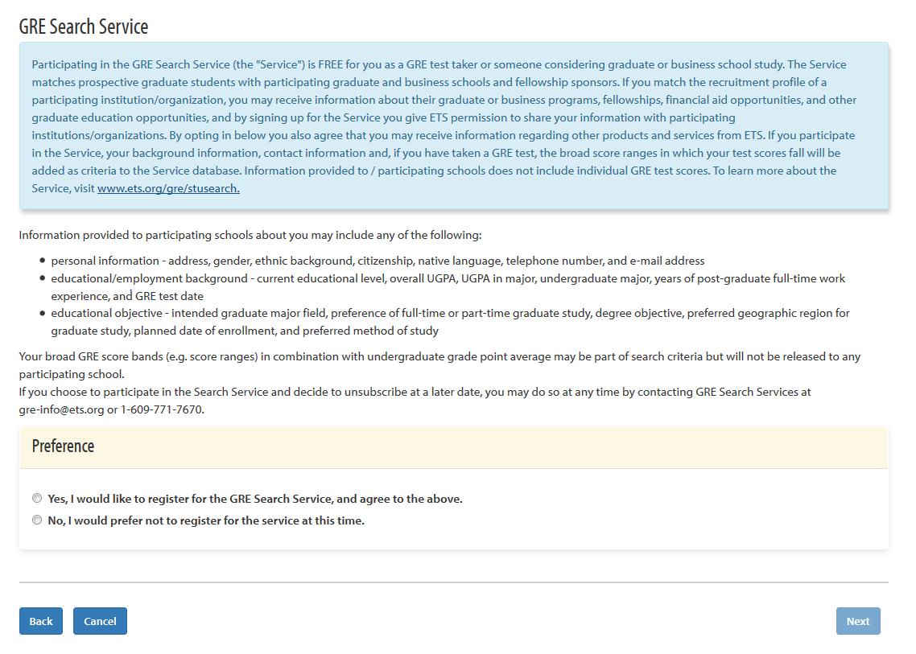
Opt In/Out
Notes:
Manuel

Slide 20
Pay for Exam
https://www.ets.org/gre/revised_general/about/fees
Notes:
Manuel

Slide 21
GRE Breakdown
Notes:
Manuel
https://www.ets.org/gre/institutions/about/general/

Slide 22
Notes:
Kim

Slide 23
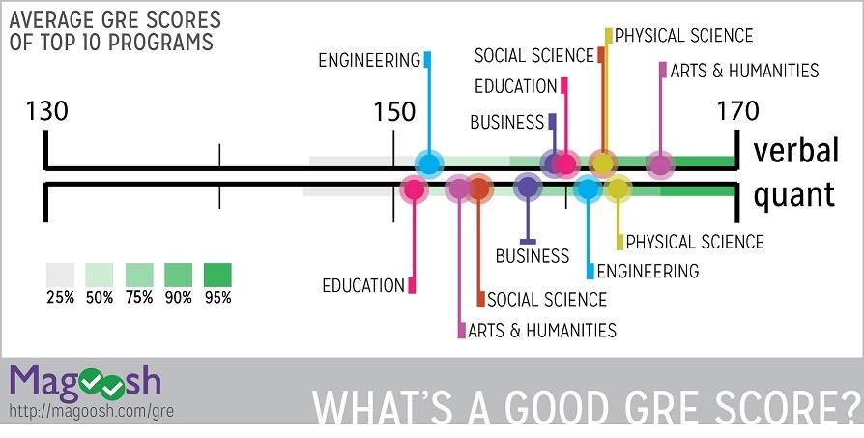
What is a good score?
Notes:
Kim
http://www.kaptest.com/blog/grad-school-insider/2014/11/24/average-gre-scores-top-grad-school-programs/

Slide 24
A good score is the score that gets you where you want to go!
For top graduate programs in engineering:
Princeton reports that its average GRE scores for admitted students are 161 V and 162 Q.
Harvard showed that its average scores for successful applicants to the engineering program are 161 V, 165 Q, and 4.3 AW.
USC’s averages in engineering are 155 V and 159 Q.
Notes:
Kim
http://www.kaptest.com/blog/grad-school-insider/2014/11/24/average-gre-scores-top-grad-school-programs/

Slide 25
What's Next?
1. Writing English proficiency test: (international students only)
2. Shortlisting universities: select universities based on your profile, area of interest, budget, reputation, market value etc. (6-10 universities to be safe)
3. Undergraduate transcripts: The schools you are going to apply to will ask for you academic records from the institution you received/pursuing your under graduate degree from.
4. Writing a statement of purpose: Graduate schools usually require an essay outlining your interests and reasons behind pursuing graduate studies. This is considered a pivotal aspect of your application and calls for investing time.
5. Getting letters of recommendations: You might be asked to provide letters of recommendations (usually three) from either your professors during you under graduate studies or from your colleagues if you are a working professional.
6. Completing the online application process: You might be asked to upload your statement of purpose and the scanned copy of your transcripts during online application process.
7. Sending GRE scores to the university via ETS: (TOEFL if you are an international applicant)
8. WAIT!: It usually takes one to three months for the universities to make a decision regarding your application.
Notes:
Kim
https://www.quora.com/What-will-happen-after-clearing-GRE

Slide 26
Study Schedule
1 Week
1 Month
2-3 Months
6 Months
http://magoosh.com/gre/gre-study-plans-and-guides/
Notes:
Students

Slide 27
Study Resources
ETS
Lynda.com
Kaplan
Manhattan Prep Books
Barron’s GRE Prep
Apps – Illustrate, Pocket GRE Math, Magoosh GRE Prep: Math, Verbal & Writing Videos, GRE+
Local Libraries – University Library has 5 GRE Books available to checkout
Notes:
Students

Slide 28
ETS Study Pricing
https://www.ets.org/gre/revised_general/about/fees
Notes:
Students

Slide 29
Some Tips From a Student
Used Barron’s GRE Prep book, Manhattan Prep Books, and Kaplan GRE Prep notecards
Take diagnostic tests in Barron’s books. Then study weakness. Then take another test.
Barron’s book comes with CD and 2 practice tests.
Take test on computer because this is how it will be done and is different than paper test
Use only the materials you will have on the day of the test
Manhattan Prep books are subject specific. Get the ones associated with your weak subjects.
Register your book and get access to 6 practice computer GRE exams and a calculator similar to what is allowed on the exam
You might look at their practice GRE book (thousands of questions)
Kaplan GRE Prep notecards gets you access to an App
Look for online databases of GRE writing prompts
Lynda.com has a GRE prep video series. Free for UA students.
Notes:
Students

Slide 30
Interactive Discussion
Notes:
Students

Slide 31
Get into groups of 3 or 4
Write down 2 to 3 GRE studying tips
Select a representative to share tips

Slide 32
Questions
Graduate students’ GRE experiences

